Slide 1
Understanding New Jersey’s Universal Waste Rules
Bureau of Hazardous Waste & UST Compliance and Enforcement
Martin E. Sánchez

Slide 2
Topics to be Covered
What is Universal Waste?
Waste streams regulated under the Universal Waste Rule (UWR)?
Requirements for Universal Waste Handlers
Best Management Practices

Slide 3
What is Universal Waste?
Universal Waste (UW) is a specific, generally a hazardous waste stream, that the US EPA and states designated by rule to be a UW.
Allows for alternative management options for these specific hazardous waste streams.
Only the waste streams identified in the UWR may be managed as UW.

Slide 4
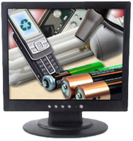
Why Universal Waste? EPA Criteria
Generated in similar quantities by businesses, industry and consumers.
Found in the municipal solid waste stream.
Routinely fails the hazardous waste test.
Negatively impacts solid waste operations.
When properly managed, presents low risk in the collection, storage & transportation.

Slide 5
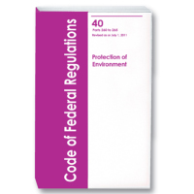
Universal Waste Rule
US EPA - adopted in 1994 under RCRA and can be found in 40 CFR part 273.
NJ - adopted in 1996 under the SW Recycling Regulations and can be found in N.J.A.C. 7:26A-7 et. seq.
Each state may choose to adopt additional waste streams provided it meets EPA’s criteria.

Slide 6
Management of UW
UW does NOT have to be stored in a designated hazardous waste accumulation/storage area.
UW is NOT counted towards the monthly hazardous waste generation amounts.
UW does NOT have to transported by a licensed hazardous waste transporter using a hazardous waste manifest.

Slide 7
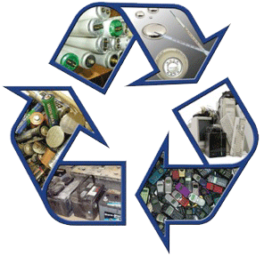
EPA (Federal) & NJ Listed UW
Federal Listed UW
Batteries
Mercury Containing Devices
Pesticides
Hazardous Lamps
NJ Listed UW
Consumer Electronics
Oil-based Finishes

Slide 8
NJ’s Recycling Regulations
Class A Recyclable Material
Curbside recyclables (glass, paper, plastic)
Class B Recyclable Material
Construction materials (concrete, wood, tires)
Class C Recyclable Material
Compostable Material
Class D Recyclable Material
Used oil and Universal Waste

Slide 9
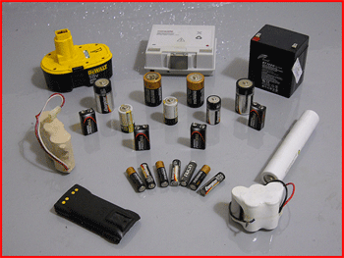
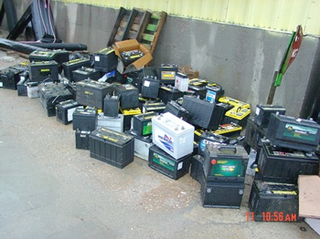
Types of UW - Definitions
Batteries - device consisting of one or more electrically connected electrochemical cells that is designed to receive, store and deliver electric energy.

Slide 10
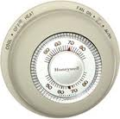
Types of UW – Definitions cont.
Mercury Containing Equipment - product component that uses elemental mercury, sealed in an ampule or other container, as a functional component. (i.e. mercury switches, thermometers & thermostats)

Slide 11
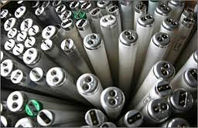
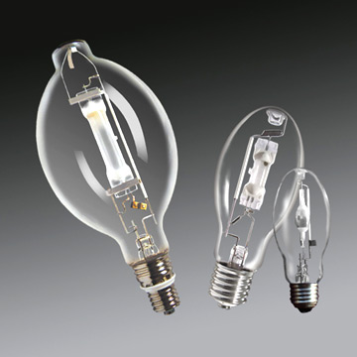
Types of UW – Definitions cont.
Lamps - bulb or tube portion of an electric lighting device. (i.e. fluorescent, high intensity discharge, neon, mercury vapor, high pressure sodium & metal halide lamps.

Slide 12
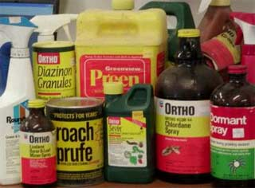
Types of UW – Definitions cont.
Pesticides – Spent and/or any unused pesticides destined for disposal.

Slide 13
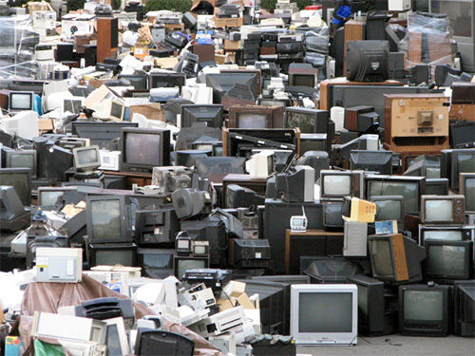
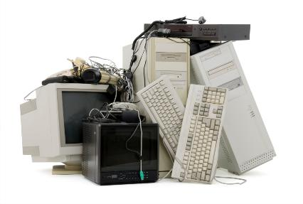
Types of UW – Definitions cont.
Consumer Electronics - appliance used in the home or business that includes circuitry. (i.e. components & subassemblies of the electronic products including computers, printers, copiers, VCRs & televisions.

Slide 14
Types of UW – Definitions cont.
Non-Hazardous Consumer Electronics –
If classified as non-hazardous, the consumer electronics can be managed as Solid Waste or Universal Waste.

Slide 15
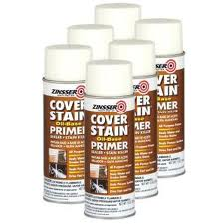
Types of UW – Definitions cont.
Oil-based Finishes- paint or other finish that may exhibit a hazardous waste characteristic or contains a listed hazardous waste. Must be in original packaging. (i.e. oil-based paints, lacquers, stains and aerosol paint cans)

Slide 16
Types of UW – Definitions cont.
LATEX PAINT
Is classified as a non-hazardous, therefore is NOT a Universal Waste.
Can be managed as a Class D Recyclable material provided the management requirements for oil-based finishes are followed.

Slide 17
What is a UW Handler?
A generator of universal waste or
The owner or operator of a facility that receives UW from other UW handlers, accumulates UW and ships UW to another UW handler, to a destination facility or to a foreign destination.
Two types of UW Handlers: Small Quantity and Large Quantity

Slide 18
Types of UW Handlers
Small Quantity Handler –
Accumulates less than 11,000 lbs. (5,000 kg.) of UW (combined) at any given time.
Large Quantity Handler –
Accumulates more than 11,000 lbs. (5,000 kg.) of UW (combined) at any given time.

Slide 19
Requirements for UW Handlers
All UW Handlers must:
Label/mark UW containers / materials properly
Accumulate UW within one year
Maintain records to prove material was accumulated within one year.
Ship off-site UW to another handler or a destination facility

Slide 20
Requirements for UW Handlers
All UW Handlers cont.
Contain and clean-up all UW releases/spills
Determine resulting release/spill is a hazardous waste and manage appropriately.
May export UW to foreign destinations and comply with portions of 40 CFR 262 Subpart E – Exports of Hazardous Waste

Slide 21
Requirements for UW Handlers
SMALL QUANTITY HANDLER
Limited processing allowed:
Removal of mercury ampules from mercury containing devices.
Demanufacturing of consumer electronics allowed.
Inform employees of proper handling and emergency procedure

Slide 22
Requirements for UW Handlers
LARGE QUANTITY HANDLERS
Notify the Department of UW handling activities by obtaining EPA ID number.
Limited processing allowed:
Removal of mercury ampules from mercury containing devices.
Oil based paints – open containers for repackaging purposes only. No processing allowed (filtering, blending or tinting).

Slide 23
Requirements for UW Handlers
LARGE QUANTITY HANDLERS
Consumer Electronics - No disassembling (“de-manufacturing”)or processing activities allowed unless approved by Department (Class D facility permit).
Processing activities include crushing, shredding or thermal altering.
Degaussing and puncturing activities allowed.

Slide 24
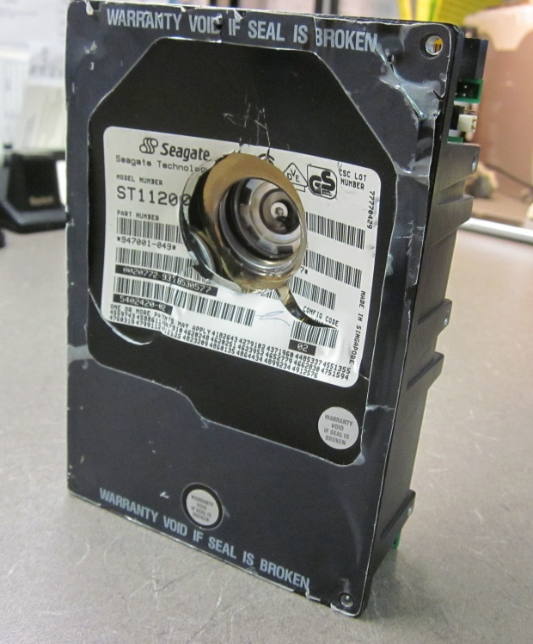
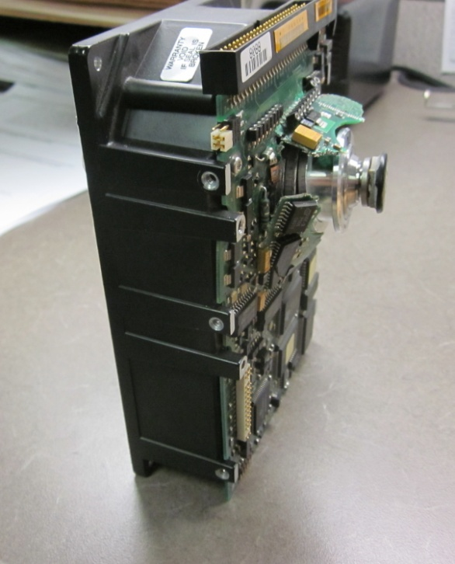
Requirements for UW Handlers
LARGE QUANTITY HANDLERS cont.
Example of a Punctured Hard Drive

Slide 25
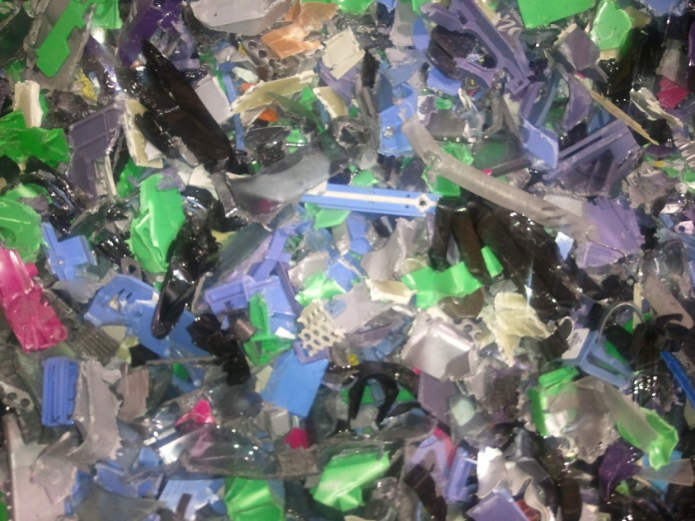
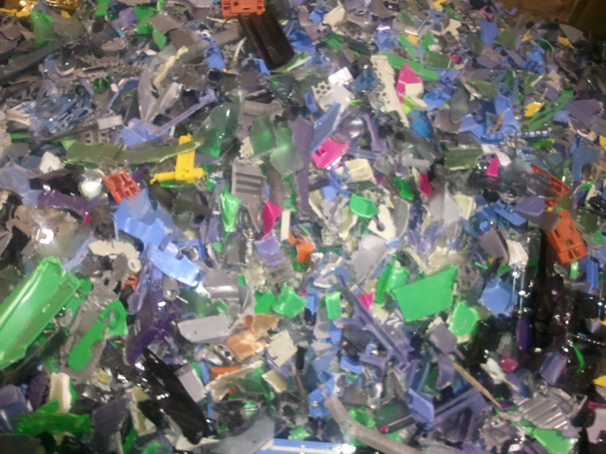
Requirements for UW Handlers
LARGE QUANTITY HANDLERS cont.
Example of a Shredded Hard Drive

Slide 26
Reporting Requirements
 | US EPA ID NUMBER | NJDEP NOTIFICATION | ANNUAL FACILITY REPORT | ANNUAL TONNAGE REPORT
SMALL QUANTITY HANDLER | NO | NO | NO | NO
LARGE QUANTITY HANDLER | YES | YES | YES | NO

Slide 27
Reporting Requirements cont..
ANNUAL FACILITY REPORT (N.J.A.C. 7:26A-7.5) – required for LQ Handlers ONLY.
Report must include:
Type of UW
Amount – Stored, received & shipped
Report submitted to Department by March 1st for previous years UW
Sent in letter form to NJDEP UW Program

Slide 28
Management of UW
UW Transporters
A person engaged in the off-site transportation of UW by air, rail, highway or water.
UW Destination Facility
Either a hazardous waste (RCRA) Treatment, Storage & Disposal facility or Class D Recycling facility.

Slide 29
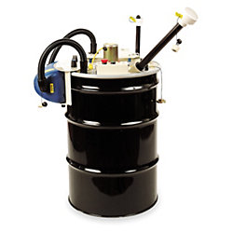
Fluorescent Lamps Crushing Devices
Fluorescent lamps are UW only when managed whole/intact (includes “incidental breakage”).
Lamps that are purposely crushed in a lamp (bulb) crushing device are NO LONGER considered as UW, and are fully regulated as Hazardous Waste.
Lamp Drum Top Crushing (DTC)machines release Mercury in the air.

Slide 30
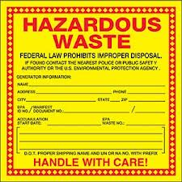
Fluorescent Lamps Crushing Devices
DTCs and other bulb crushing devices require an Air Pollution Control permit from the Department. See N.J.A.C. 7:27-8.2(c)(17)
Containers holding the crushed lamps must be managed as a hazardous waste.

Slide 31
Fluorescent Lamps Crushing Devices
Proper use of DTCs must include at a minimum:
Segregated Operations
Employee Training & Notification Procedures
Protective Equipment for Operators of DTCs
Mercury Emission Monitoring
Operational Log

Slide 32
UW Destination Facilities
Regulated as either a RCRA TSDF if conducting treatment of UW or a Class D Recycling center if conducting recycling activities.
Class D Recycling center - must obtain from the Department an approval to conduct recycling activities (processing).
Recycling activities include:
Demanufacturing of Consumer electronics
Crushing UW Lamps or computer monitors (CRTs)
Mixing & screening of UW – oil based paints
Recovery of Mercury from UW – Mercury containing devices.

Slide 33
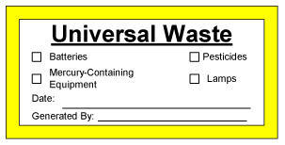
UW Labeling / Marking
Handlers and Destination facilities must label and/or mark UW containers or items properly.
i.e. “Universal Waste – Lamps” or “Waste Lamps” or “Used Lamps”
Markings must be visible, legible and clear.
Recommended – Accumulation start date.
Pesticides – original label must remain affix along with the UW marking “Universal Waste – Pesticide” or “Waste Pesticide”

Slide 34
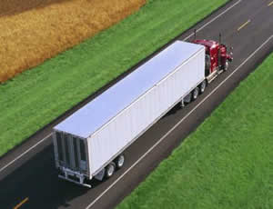
Transportation Requirements
Transported in accordance with the US Dept. of Transportation (USDOT) requirements: Packaging, labeling, marking, placarding and preparing shipping papers. http://phmsa.dot.gov/hazmat
UW sent to a Class D Recycling Center or Handler do NOT have to be transported by NJ Licensed SW/HW Transporter.
UW sent to a RCRA TSDF must be transported by NJ Licensed SW/HW Transporter.

Slide 35
Best Management Practices - Guide
Planning: Several options include - Mail-in boxes, Contract recycling, Pickup & recycle services and Household hazardous waste collections.
Designating Accumulation area: Suitable location – Ample room/space, away from high traffic areas, protected from falling objects & secure from vandalism.
Signs: Clearly stating “UNIVERSAL WASTE” and/or warning signs such as: “Do not stack boxes on this rack” and “Handle boxes with care”.
Training Employees: Proper handling of the universal waste including containerizing (choosing the right container), labeling, & responding to spills (i.e. broken lamps).
Retaining Records – shipping documents, training records, and inspection records

Slide 36
Summary
UW are still hazardous waste, subject to reduced management requirements.
UW in NJ: batteries, pesticides, mercury containing devices, hazardous waste lamps, consumer electronics & oil-based finishes.
Crushed lamps are no longer UW, must be managed as hazardous waste.
UW Handlers – generators & accumulators of UW
Recyclers of UW are regulated as Class D Recycling centers.
Develop a Best Management Practice for your facility using UW rules as your guide.

